Slide 1
Introductory
Intended learner audience
For all parents who have young children or teenagers to feed at home.
Learning objectives
Know the reason why our children need healthy food
Recognize good eating habits to keep
Learn what we need to do to help our children eat healthy
Get some meal recipes
Let’s begin!

Slide 2
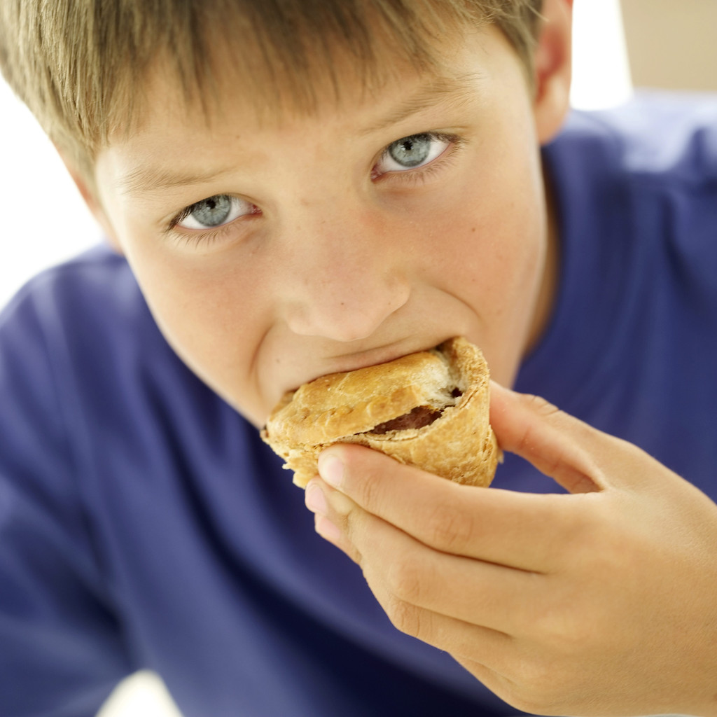
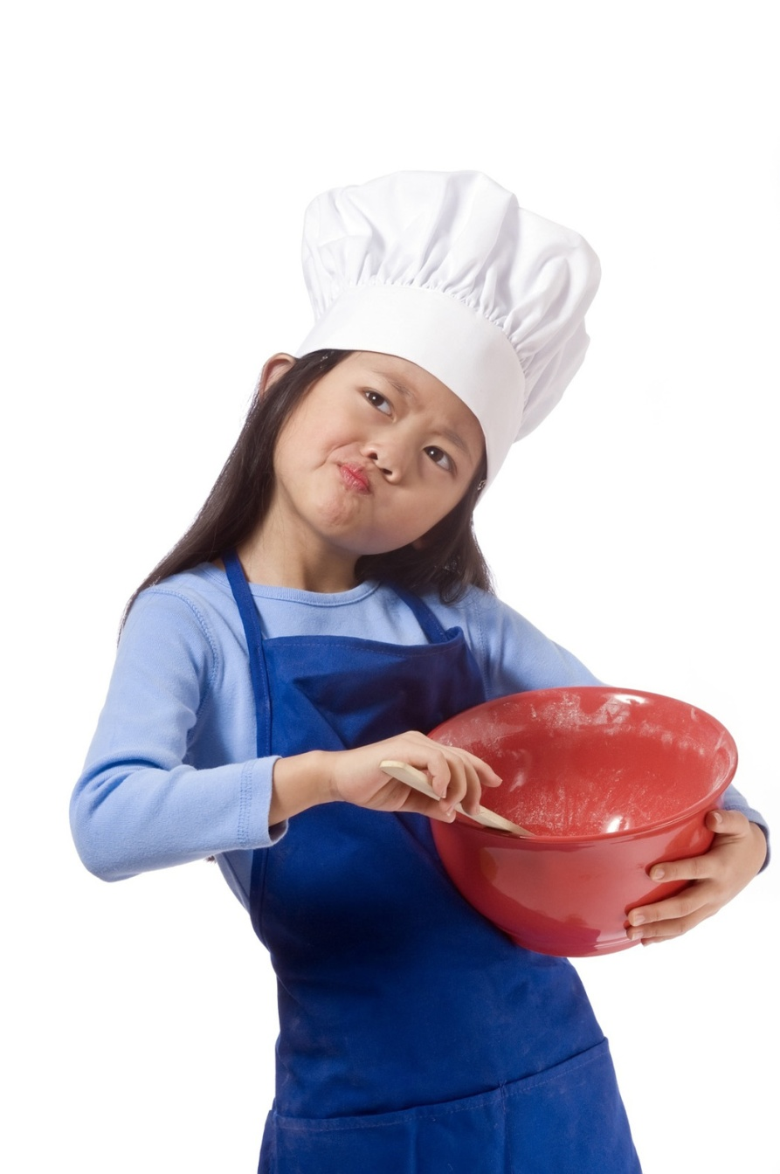
How do I feed my baby doll?
------ Nutrition and Recipes for Children
Click here to get started!

Slide 3
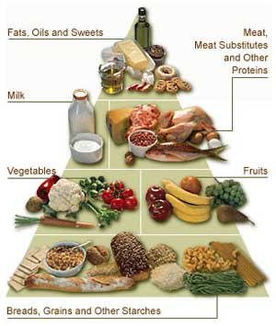
Why eat healthy food?
Physical changes of all kinds
Growth and development
Nourishing food makes a child healthier
Nourishing food makes a child emotionally more stable
Nourishing food improves school performance
Quiz
Notes:
All parents want their children to be healthy. As elementary school aged children go through remarkable physical changes of all kinds, their food intake becomes a critical aspect of this growth and development. Recent research shows that nourishing food not only makes a child healthier, it makes him emotionally more stable, and it improves school performance. It appears then that paying attention to our children's diets pays high dividends. If only our children thought so, too! Because children tend to rank their parents' views on food along with their unpopular views on curfews, rock music, hair styles, etc., it is up to the parents to, first of all, be clever about insinuating nutritious foods into the family menus and, secondly, take a reasonable but hard line when other approaches fail.

Slide 4
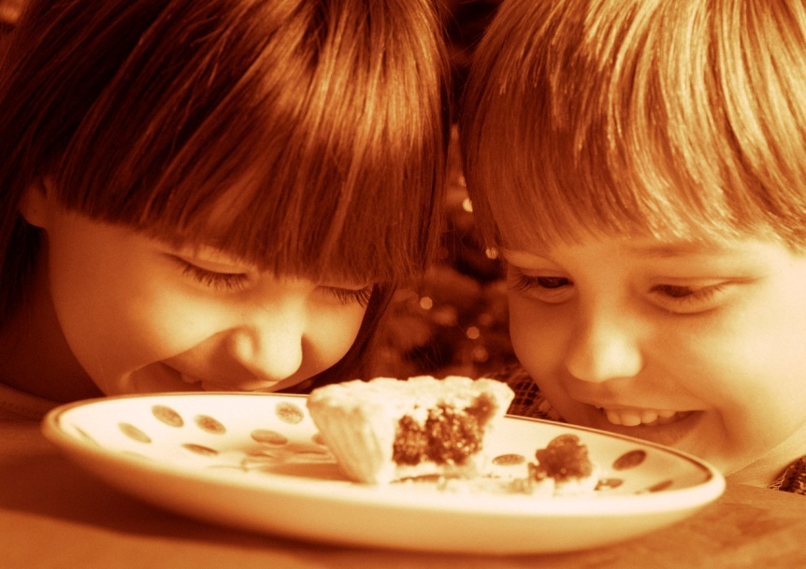
Reasons for kids to eat healthy food
Good habits to keep
Growth and Development
Healthy Food Intake
Meals and Recipes
Junk Food
Videos
Quiz
Notes:
In the next a few slides, we’ll look more into Reasons for kids to eat healthy food, Good Eating habits to keep, we’ll go over three important meals, and introduce some good recipes. Junk food is included as well. In the end, we’ll have some link available for video tutorials, and of course, to test how much you have learned, take a quiz! Feel free to navigate to your favorite sections by clicking on these boxes around the photo, or simply click Continue to explore more.

Slide 5
Good Eating Habits to Keep
Have regular family meals.
Serve a variety of healthy foods and snacks.
Be a role model by eating healthy yourself.
Avoid battles over food.
Involve kids in the process.
Quiz
Next
Notes:
Whether you have a toddler or a teen, here are five of the best strategies to improve nutrition and encourage smart eating habits:
Have regular family meals.
Serve a variety of healthy foods and snacks.
Be a role model by eating healthy yourself.
Avoid battles over food.
Involve kids in the process.
But it's not easy when everyone is juggling busy schedules and convenience food, such as fast food, is so readily available.
Here are some ways to incorporate all five strategies into your routine.
Family Meals
Family meals are a comforting ritual for both parents and kids. Children like the predictability of family meals and parents get a chance to catch up with their kids. Kids who take part in regular family meals are also:
more likely to eat fruits, vegetables, and grains
less likely to snack on unhealthy foods
less likely to smoke, use marijuana, or drink alcohol
In addition, family meals offer the chance to introduce kids to new foods and to act as a role model for healthy eating.
Teens may turn up their noses at the prospect of a family meal — not surprising because they're busy and want to be more independent. Yet studies find that teens still want their parents' advice and counsel, so use mealtime as a chance to reconnect. Also, consider trying these strategies:
Allow your teen to invite a friend to dinner.
Involve your teen in meal planning and preparation.
Keep mealtime calm and congenial — no lectures or arguing.
What counts as a family meal? Any time you and your family eat together — whether it's takeout food or a home-cooked meal with all the trimmings. Strive for nutritious food and a time when everyone can be there. This may mean eating dinner a little later to accommodate a child who's at sports practice. It can also mean setting aside time on the weekends, such as Sunday brunch, when it may be more convenient to gather as a group.
Stocking Up on Healthy Foods
Kids, especially younger ones, will eat mostly what's available at home. That's why it's important to control the supply lines — the foods that you serve for meals and have on hand for snacks. Follow these basic guidelines:
Work fruits and vegetables into the daily routine, aiming for the goal of at least five servings a day. Be sure you serve fruit or vegetables at every meal.
Make it easy for kids to choose healthy snacks by keeping fruits and vegetables on hand and ready to eat. Other good snacks include low-fat yogurt, peanut butter and celery, or whole-grain crackers and cheese.
Serve lean meats and other good sources of protein, such as fish, eggs, beans, and nuts.
Choose whole-grain breads and cereals so kids get more fiber.
Limit fat intake by avoiding deep-fried foods and choosing healthier cooking methods, such as broiling, grilling, roasting, and steaming. Choose low-fat or nonfat dairy products.
Limit fast food and low-nutrient snacks, such as chips and candy. But don't completely ban favorite snacks from your home. Instead, make them "once-in-a-while" foods, so kids don't feel deprived.
Limit sugary drinks, such as soda and fruit-flavored drinks. Serve water and low-fat milk instead.
How to Be a Role Model
The best way for you to encourage healthy eating is to eat well yourself. Kids will follow the lead of the adults they see every day. By eating fruits and vegetables and not overindulging in the less nutritious stuff, you'll be sending the right message.
Another way to be a good role model is to serve appropriate portions and not overeat. Talk about your feelings of fullness, especially with younger children. You might say, "This is delicious, but I'm full, so I'm going to stop eating." Similarly, parents who are always dieting or complaining about their bodies may foster these same negative feelings in their kids. Try to keep a positive approach about food.
Don't Battle Over Food
It's easy for food to become a source of conflict. Well-intentioned parents might find themselves bargaining or bribing kids so they eat the healthy food in front of them. A better strategy is to give kids some control, but to also limit the kind of foods available at home.
Kids should decide if they're hungry, what they will eat from the foods served, and when they're full. Parents control which foods are available to the child, both at mealtime and between meals. Here are some guidelines to follow:
Establish a predictable schedule of meals and snacks. It's OK to choose not to eat when both parents and kids know when to expect the next meal or snack.
Don't force kids to clean their plates. Doing so teaches kids to override feelings of fullness.
Don't bribe or reward kids with food. Avoid using dessert as the prize for eating the meal.
Don't use food as a way of showing love. When you want to show love, give kids a hug, some of your time, or praise.
Get Kids Involved
Most kids will enjoy deciding what to make for dinner. Talk to them about making choices and planning a balanced meal. Some might even want to help shop for ingredients and prepare the meal. At the store, teach kids to check out food labels to begin understanding what to look for.
In the kitchen, select age-appropriate tasks so kids can play a part without getting injured or feeling overwhelmed. And at the end of the meal, don't forget to praise the chef.
School lunches can be another learning lesson for kids. More important, if you can get them thinking about what they eat for lunch, you might be able to help them make positive changes. Brainstorm about what kinds of foods they'd like for lunch or go to the grocery store to shop together for healthy, packable foods.
There's another important reason why kids should be involved: It can help prepare them to make good decisions on their own about the foods they want to eat. That's not to say they'll suddenly want a salad instead of french fries, but the mealtime habits you help create now can lead to a lifetime of healthier choices.

Slide 6
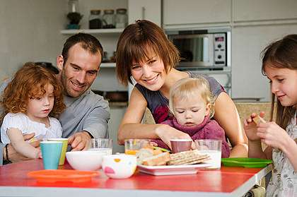
Good Eating Habits to Keep
Family meals
more likely to eat fruits, vegetables, and grains
Family meals are a comforting ritual.
less likely to snack on unhealthy foods
introduce kids to new foods
Next

Slide 7
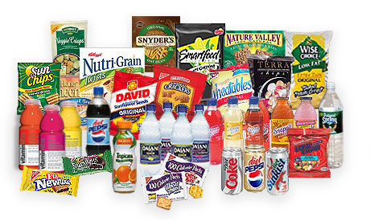
Good Eating Habits to Keep
Stocking Up on Healthy Foods
Work fruits and vegetables into the daily routine
They eat mostly what's available at home
Make it easy for kids to choose healthy snacks
Serve lean meats and other good sources of protein
Choose whole-grain breads and cereals
Limit fat intake
Limit sugary drinks
Next

Slide 8
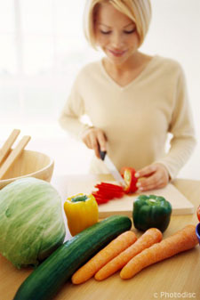
Good Eating Habits to Keep
How to Be a Role Model
serve appropriate portions
eat well yourself
Don’t complain about your bodies
keep a positive approach about food
Next

Slide 9
Good Eating Habits to Keep
Don't Battle Over Food
Don’t bargain or bribe kids
Don't force kids to clean their plates
give kids some control
Don't use food as a way of showing love
Establish a predictable schedule of meals and snacks
Next

Slide 10
Good Eating Habits to Keep
Get Kids Involved
Most kids enjoy deciding what to make for dinner
help shop for ingredients and prepare the meal
teach kids to check out food labels
praise the chef
Three Meals

Slide 11
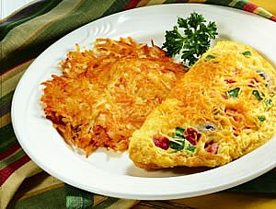
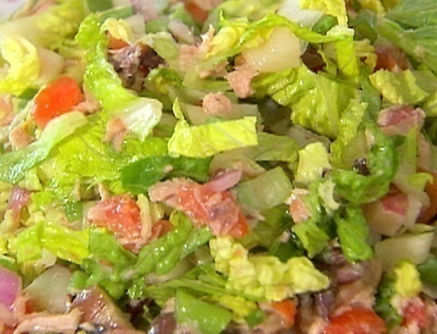
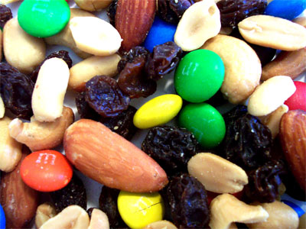
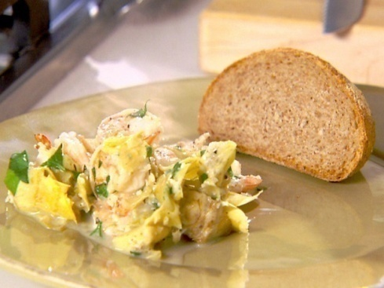
Three Meals
Click on pictures or boxes below to learn more about our daily meals.
Breakfast
Lunch
After School Snack
Dinner
Quiz

Slide 12
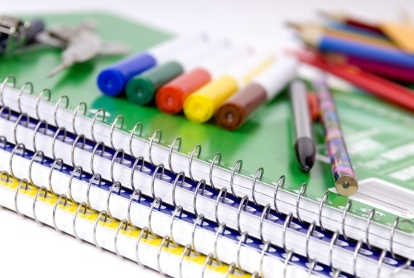
Breakfast
I’m sleepy, and I’m hungry too!
X
I love doughnut, but DON’T give it to me!
I need my brain in the morning, help me!
Three Meals Menu
Breakfast Continues
Notes:
A child in the classroom whose last meat was dinner the night before has gone about sixteen hours without food, and that child is hungry, whether he knows it or not. A nutritious breakfast will provide energy for several hours-until lunch, in fact. Is any kind of breakfast better than no breakfast at all? Unfortunately, no. A doughnut, for example, provides a quick rush of energy that lasts about 40 minutes, about the length of time it takes the youngster to get from the breakfast table to his classroom!
Traditionally, teachers schedule "heavy" subjects, such as reading and arithmetic, during the morning hours, and so it becomes even more important that the child's brain be fueled. The following suggestions have proved helpful in sending youngsters off to school ready to team.
Offer options. "Here's what's for breakfast. You have two choices. Pick one of them." Just be sure that both choices have high nutritive value.

Slide 13
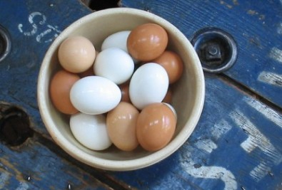
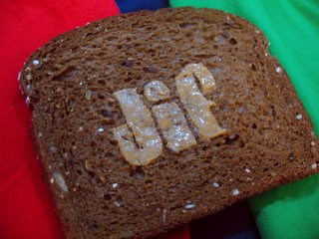
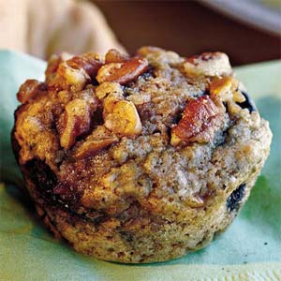
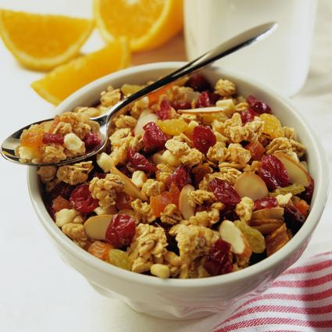
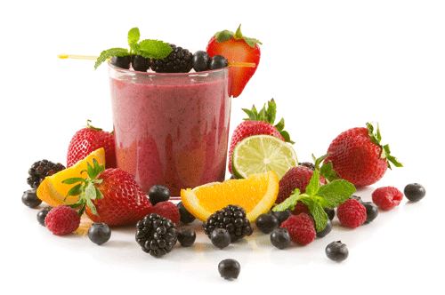
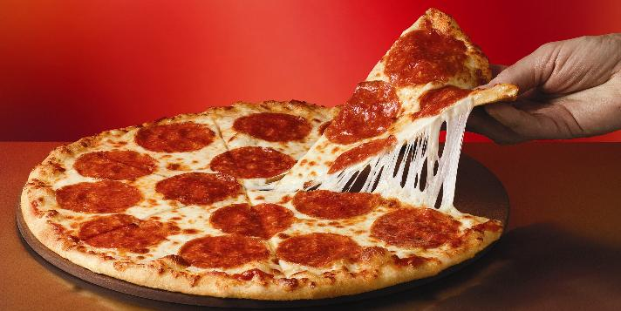
Breakfast
Three Meals Menu
Breakfast Continues
Notes:
Put the blender to good use. Concoct a shake or smoothie with milk, vanilla, and a couple of tablespoons of honey. There is an unlimited assortment of blended breakfast drinks with all sorts of combinations: orange juice, bananas, apple juice, wheat germ, etc. Eight ounces of such a drink served over shaved ice with a couple of slices of whole, wheat toast will keep any youngster on his toes until noon.
If the youngster likes cereal, dry or cooked, give it an extra boost with a sprinkling of wheat germ. chopped nuts, raisins, or other fruit.
Leftover pizza doesn't make a bad breakfast. It's more nutritious than any other fast food, and you can increase its nutrition by adding extra cheese.
Layer yogurt, fruit, and granola in glasses for a parfait look.
Try a breakfast buffet with sliced fresh fruits, finger food vegetables, hard-boiled eggs, whole-wheat muffins. The more colorful, the better, and kids love to help themselves.

Slide 14
Breakfast
Sweet omelets are sort of a cross between crepes and pancakes. They are a great option for the many followers of low carbohydrate diets. They can be used for the base of a delicious and healthy breakfast or dessert.
Broccoli and Cheddar Frittata
Three Meals Menu
Breakfast Continues
Notes:
Our recipe for the breakfast is Broccoli and Cheddar Frittata. You can learn at your own pace on the following slides.

Slide 15
Broccoli and Cheddar Frittata Instructions
Cook Time
15 min
Level
Easy
Yield
4 servings
Three Meals Menu
Breakfast Continues

Slide 16
Broccoli and Cheddar Frittata Ingredients
8 large eggs
2 tablespoons water
2 teaspoons olive oil
1 small red onion, sliced (about 1 cup)
2 cups chopped cooked broccoli
1/4 teaspoon salt
Freshly ground black pepper
1/2 cup shredded extra-sharp Cheddar (2 ounces)
Three Meals Menu
Breakfast Continues

Slide 17
Broccoli and Cheddar Frittata Directions
Separate 4 of the eggs, putting the whites into a medium sized bowl and discarding the yolks (or saving them for another purpose). Add the remaining 4 whole eggs and 2 tablespoons of water to the whites and whisk well.
In a medium ovenproof nonstick skillet heat the oil over a medium flame. Add the onion and cook until it begins to soften, about 5 minutes. Add the broccoli and cook for another 2 minutes. Season with salt and a few turns of pepper. Pour the egg mixture over the vegetables in the skillet covering them evenly. Reduce the heat to medium-low, cover, and let cook until the egg mixture has set around the edges but is somewhat liquid in the middle, about 8 minutes. Sprinkle with the cheese.
Meanwhile, preheat the broiler. Place the skillet under the broiler about 2 inches from the heat until the surface is set and golden brown, 1 to 2 minutes. Be careful not to overcook or the egg mixture will become tough.
Cut the frittata into 8 wedges and serve.
Return to Three Meals Menu
Lunch

Slide 18
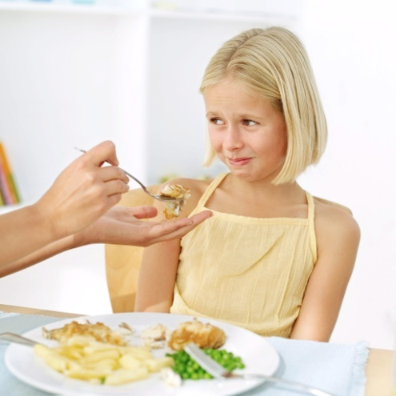
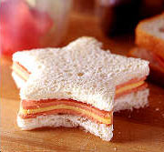
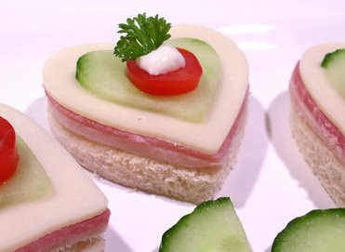
Lunch
I don’t care about my lunch.
I just want some fun.
Three Meals Menu
Lunch Continues
Notes:
The sack lunch! Does the child give, trade, or throw most of it away? (The clue is if he comes home ready to eat anything and everything in the refrigerator!) It's altogether possible that the youngster is jettisoning his sack lunch because he is bored to tears with it, so it's time for the parents to get creative. One clever parent inserts a smaller bag labeled "this is for trading" into the larger bag, and it seems to work wonders! The following suggestions may help.
Apples and oranges certainly qualify on all counts-nutritious, no preparation, relatively inexpensive. But they're also easy to toss in the garbage can! Get a couple of plastic containers with lids that stay on and fill them with fruit cocktail, applesauce, mandarin orange slices, yogurt, even popcorn or Crackerjacks.
Use cookie cutters to shape sandwiches, crinkle-cut carrots, stuff some celery. If your youngster is a peanut butter addict-and most are-add any of the following to peanut butter for a change from the tried and true peanut butter and jelly sandwich: chopped dates or nuts, raisins, bacon bits, applesauce, crushed pineapple.
Mix tuna fish or canned salmon with sliced cucumbers, sprouts, grated carrots hard boiled eggs, chopped celery, etc.

Slide 19
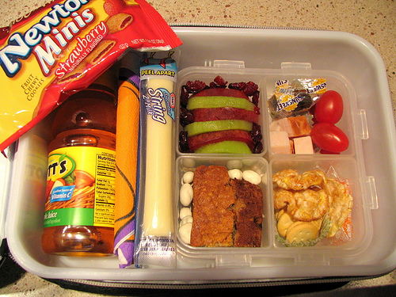
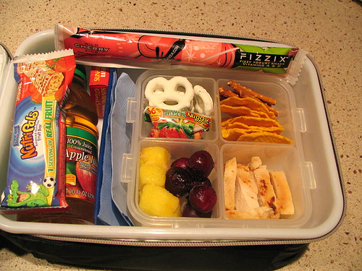
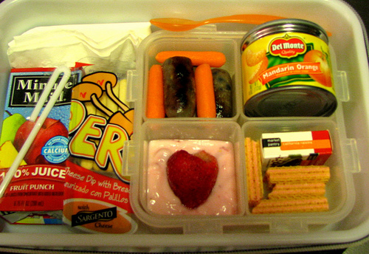
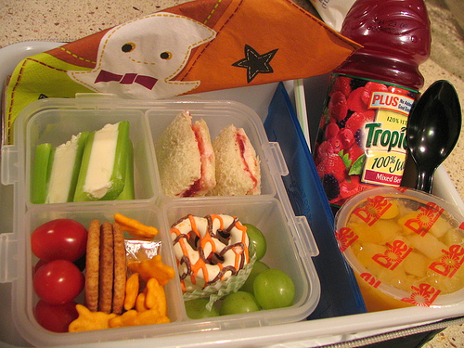
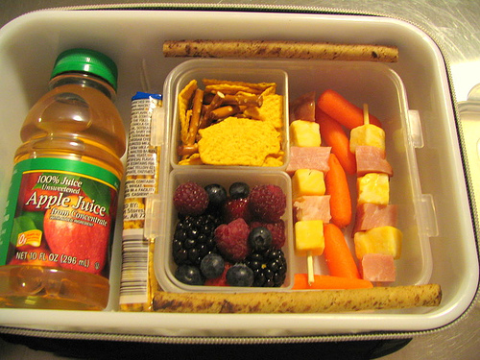
Lunch
Three Meals Menu
Lunch Continues
Notes:
Apples and oranges certainly qualify on all counts-nutritious, no preparation, relatively inexpensive. But they're also easy to toss in the garbage can! Get a couple of plastic containers with lids that stay on and fill them with fruit cocktail, applesauce, mandarin orange slices, yogurt, even popcorn or Crackerjacks.
Use cookie cutters to shape sandwiches, crinkle-cut carrots, stuff some celery. If your youngster is a peanut butter addict-and most are-add any of the following to peanut butter for a change from the tried and true peanut butter and jelly sandwich: chopped dates or nuts, raisins, bacon bits, applesauce, crushed pineapple.
Mix tuna fish or canned salmon with sliced cucumbers, sprouts, grated carrots hard boiled eggs, chopped celery, etc.

Slide 20
Chopped Nicoise Salad Instructions
Cook Time
21 min
Level
Easy
Yield
4 (2-cup)
servings
Three Meals Menu
Lunch Continues
Notes:
Our recipe for lunch is Chopped Nicoise Salad . You can learn at your own pace on the following slides.

Slide 21
Chopped Nicoise Salad Ingredients
4 small red potatoes (about 1/2 pound)
1/3 pound fresh green beans, trimmed
12-ounce can light tuna packed in water, drained
1/2 cup chopped pitted Greek or Spanish olives
1/4 cup diced red onion
2 large tomatoes, seeded and diced (about 2 cups)
5 cups chopped romaine lettuce
2 tablespoons olive oil
1/4 cup freshly squeezed lemon juice
1/2 teaspoon Dijon mustard
Salt and pepper
Three Meals Menu
Lunch Continues

Slide 22
Chopped Nicoise Salad Directions
Boil water in a large pot with a fitted steamer basket. Put the potatoes in the steamer, cover and steam for 15 minutes. Add the green beans and steam for 6 minutes more. Put the cooked potatoes and beans in a dish and set in the refrigerator to cool, or plunge into a bowl of ice water to cool quickly.
Put tuna, olives, onion, tomato and lettuce in a large bowl. Dice the potatoes and green beans, add them to the bowl and toss.
In a small bowl whisk together the oil, lemon juice, mustard, salt and pepper. Pour the dressing over the salad, toss well and serve.
Three Meals Menu
After School Snacks

Slide 23
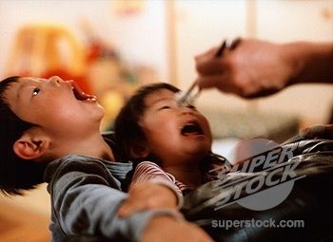
After School Snacks
I’m hungry!
X
I want something sweet.
Three Meals Menu
After School Snacks
c
Notes:
Once a child has entered the primary grades, it is no longer possible for him to eat whenever he feels hungry, and it can be a long time between lunch and the final bell. Most youngsters arrive home wanting and needing an immediate energy boost. It's a great opportunity to add some "in nutrients to the youngster's diet. To many youngsters a snack automatically means something sweet; however, sugar should be removed from the diet as much as possible except for special occasions.

Slide 24
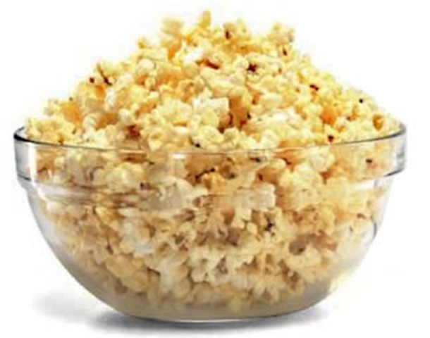
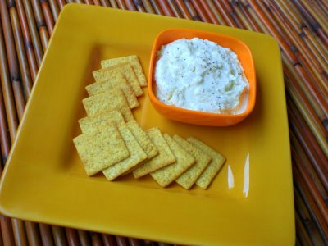
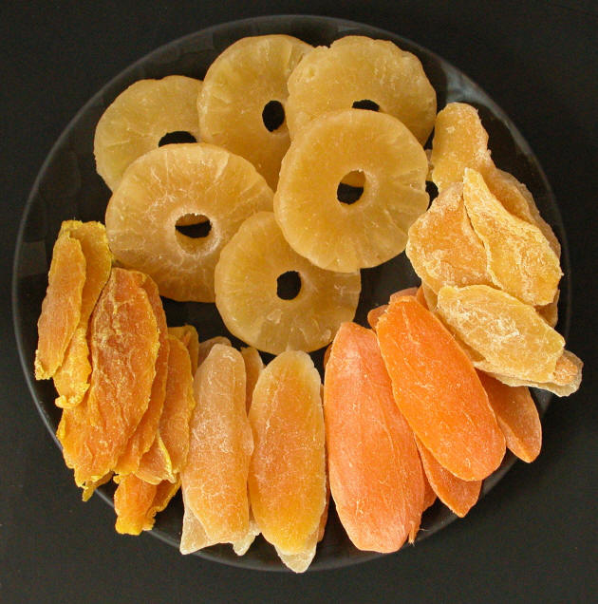
After School Snacks
Three Meals Menu
Dinner
c
Notes:
Post a "what's inside for a snack" list on the refrigerator door and let the child help himself.
Select a special spot where the child will find either that day's snack or a note telling him where to find it. (Sample: "You'll find fresh orange juice popsicles in the freezer.")
Keep a supply of trail mix in a moisture-proof container. The combinations are limitless: nuts, coconut shavings, dates, sunflower seeds, pretzel sticks, banana chips, etc.
Most youngsters like dried fruits, especially if they can spread them with peanut butter or a fruit butter.
Popcorn-youngsters love it as a snack, and it can also be sprinkled on soup.
Cheese, cheese, cheese-spread, melted or in chunks. Whole wheat crackers.

Slide 25
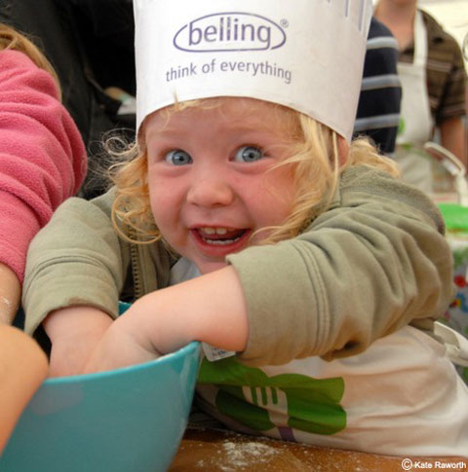
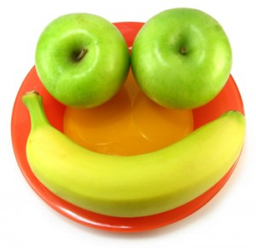
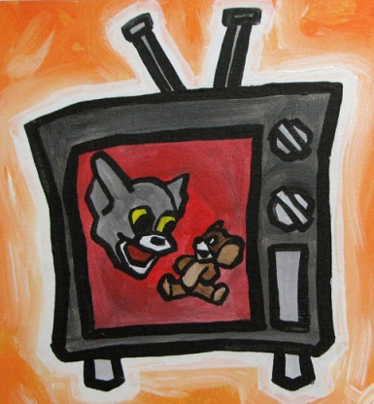
Dinner
They won’t starve to death. Trust me.
Let them decide their plate.
Make food look attractive.
X
Turn off the television set.
Three Meals Menu
Dinner Continues
c
Notes:
The time-honored tradition of breakfast, lunch, and dinner seems the best way to ensure a balanced diet, but the fact is that we may not need three meals a day. A better solution for some families may be more frequent, lighter meals. And it really isn't a matter of life and death if a family member misses dinner. No child ever starved to death because he was playing softball and forgot to come home for dinner. Common sense, flexibility, and creativity go a long way to make the evening meal pleasant.
Let the youngsters serve themselves. In this way they can decide how much to put on their plates and can always take a second serving if they want it. Involve your youngsters in the family menu. Let them suggest foods, familiar and unfamiliar, although some of their choices may need to be discussed in terms of whether or not they fit into the family budget. Occasionally take your children to the grocery store. It's a good place to give them choices. ("Do you want broiled chicken or fish for dinner? Peas or green beans? " "Pick out some fruit for your lunches this week") What you don't buy is as important as what you do buy. If you don't buy potato chips and sodas, your youngsters won't be able to snack on them.
Make food look attractive and interesting. One mother cuts liver into bite-sized pieces and sticks toothpicks in each piece. Her children eat the pieces lollipop-style with a great degree of gusto!
Turn off the television set. Make the dinner table a place for good conversation.

Slide 26
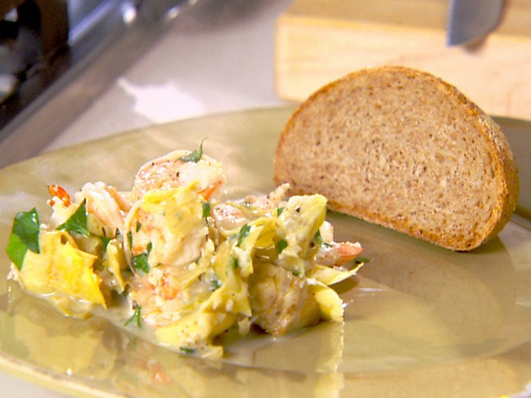
Shrimp Scampi with Artichokes Instructions
Cook Time
6 min
Level
Easy
Yield
4 servings, serving size: 2 cups
Three Meals Menu
Dinner Continues
c
Notes:
Our recipe for dinner is Shrimp Scampi with Artichokes . You can learn at your own pace on the following slides.

Slide 27
Shrimp Scampi with Artichokes Ingredients
4 small red potatoes (about 1/2 pound)
1/3 pound fresh green beans, trimmed
12-ounce can light tuna packed in water, drained
1/2 cup chopped pitted Greek or Spanish olives
1/4 cup diced red onion
2 large tomatoes, seeded and diced (about 2 cups)
5 cups chopped romaine lettuce
2 tablespoons olive oil
1/4 cup freshly squeezed lemon juice
1/2 teaspoon Dijon mustard
Salt and pepper
Three Meals Menu
Dinner Continues
c

Slide 28
Shrimp Scampi with Artichokes Directions
Heat the oil in a large skillet over medium heat. Add garlic and shallots and cook, stirring until softened but not browned, 2 to 3 minutes. Add shrimp, artichoke hearts, wine, and lemon juice and cook until the shrimp are cooked through, 3 to 4 minutes. Stir in the parsley, salt and pepper. Divide among 4 plates, garnish with additional parsley, and serve.
Three Meals Menu
Junk Food
c

Slide 29
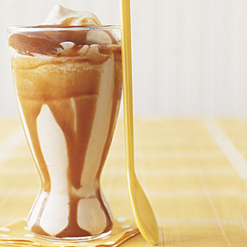
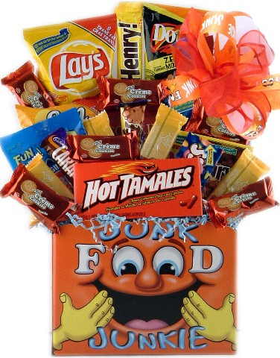
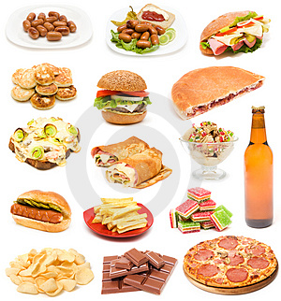
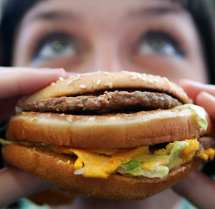
Junk Food
Video Links
Quiz
Notes:
Most of the foods served in fast food restaurants have fat as their main source of calories. Even milk shakes are often nude with highly saturated coconut oil. In addition, their foods are usually low in iron, fiber, and vitamins, and extremely high in sodium. Unfortunately, youngsters are exposed to virtually thousands of junk food television commercials a year, and parents might as well accept the fact that occasionally their children are going to head for a fast food restaurant. However, they'll survive, especially if their daily diet is nutritious.

Slide 30
Video Links
Broccoli and Cheddar Frittata
Chopped Nicoise Salad
Shrimp Scampi with Artichokes
Quiz

Slide 31
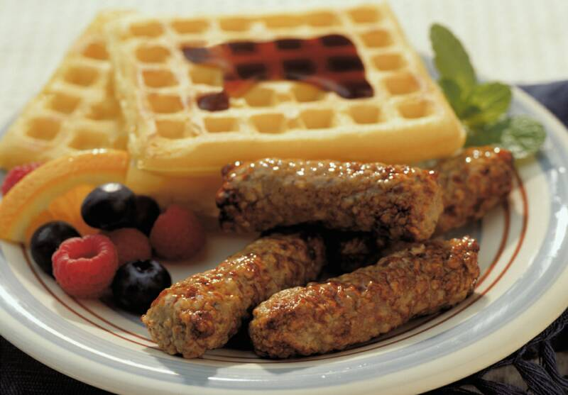
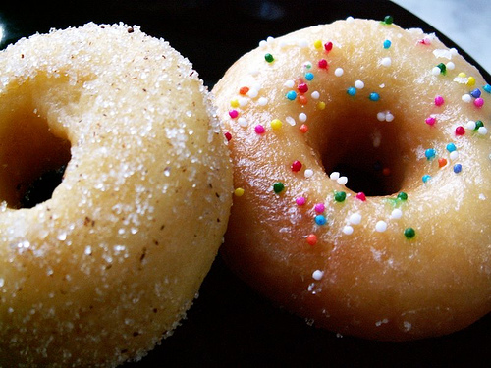
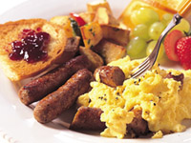
Quiz
Which of the following is the least recommended for a healthy choice of breakfast?

Slide 32
You got it!
Doughnut should be eliminated from your family diet FOREVER!
Next Quiz Question

Slide 33
Quiz
True
False
We can use dessert as the prize for eating the meal.

Slide 34
You got it!
You could show your love by hugging and kissing, dessert shouldn’t be the award for a healthy meal.
Next Quiz Question

Slide 35
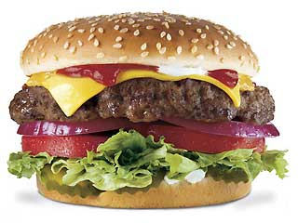
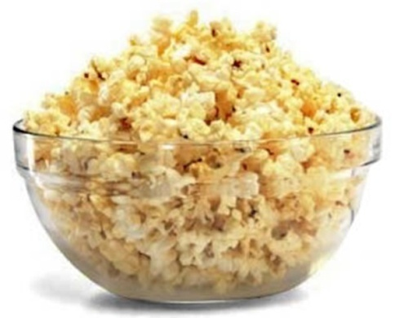
Quiz
Which of the following belongs to junk food?

Slide 36
You got it!
Hamburger is a type of fast food which is junk for sure.
Next Quiz Question

Slide 37
Quiz
Chips and candy should be limited because they are fast food and low-nutrient snacks. However, don't completely ban favorite snacks from your home. Instead, make them "once-in-a-while" foods, so kids don't feel deprived.
True
False

Slide 38
You got it!
Is it possible to never let kids eat candy? NOOOOOOOOO……..☺
Go to Game!

Slide 39
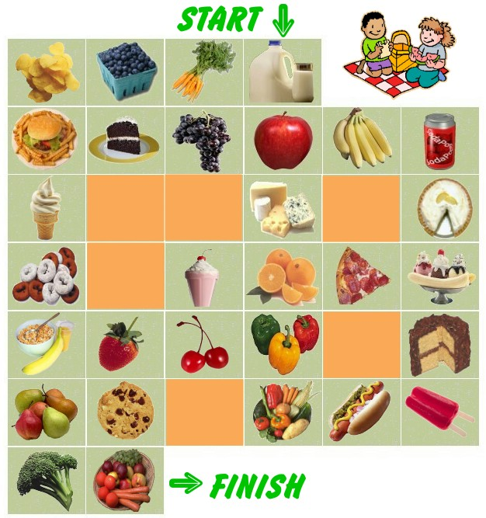
Circle the healthy snacks to make a pathway to good nutrition.
This is NOT a quiz.
You can only print it out and draw the line on paper for this game.
Are we done yet?
Click here and print a larger image!

Slide 40
Happy and Healthy Children
I’d like to give special thanks to Child Development Institute and kidshealth.org for their helpful information.
Notes:
We all love our children, but let’s make sure we start giving them a happier and healthier tomorrow today!!

